Slide 1
Notes:
What do you fear? Do you fear the past? No! You might regret the past, but you do not fear it. Do you fear the present? Possibly? Is anyone fearful right now, paralyzed and terrified with fear? No. Good! What we really fear is what, the future! Why? Because the future is unknown. We fear what might happen.

Slide 2
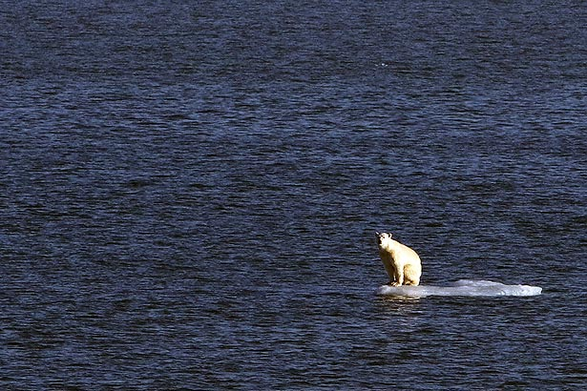
Notes:
There are many today who fear climate change. Rep. Alexandria Ocasio-Cortez D-NY, AOC says she is absolutely terrified of climate change – I mean really terrified.
Is climate change really what we should cause us to fear the future for humanity? Well, obviously not. Beside, climate change is really just code word for global socialism, which is something to fear.
Now, the day of the Lord is something we might fear, the day God will terrorize the world. But we need not even fear it, for he has promise us that we will escape that day.

Slide 3
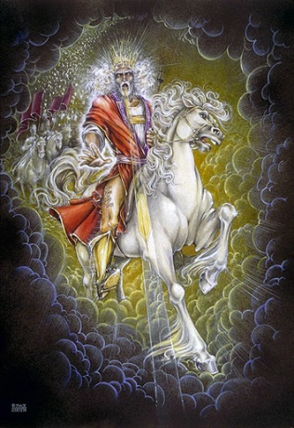
Growing in Holiness
2 PETER
The Blessed Hope is the certainty that our God and Savior Jesus Christ is retuning soon, just as He promised to rescue us before the Day of the Lord, and at the very end, the world is going to burn. In light of this Peter tells us how we should then live.
Notes:
This is the blessed hope, the certainty…
Peter tells us not to fear, but to put our hope in Christ, to live in the expectation of the prophetic promises of Jesus’ soon return to establish His glorious kingdom on earth until the conclusion of all things, and then at that time He will create an new heaven and new earth in which only righteousness will exists.
The more we are rooted in this promise and hope, the more we ought to live in holiness, adding good moral conduct to our faith, persevering in the midst of personal trials, and developing our Christian character all in the expectation of being rewarded with a rich entrance to Jesus’ future kingdom without end.

Slide 4
Growing in Holiness
in Light of the Promised Blessed Hope of the Lord and Savior’s Soon Return
Notes:
The theme of Second Peter is…

Slide 5
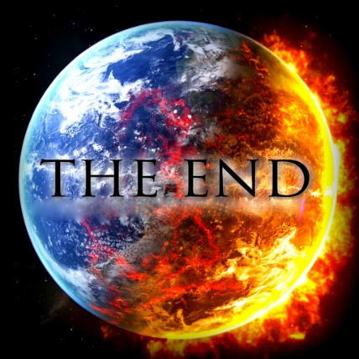
Growing in Holiness
2 PETER
Key Verse:
“Therefore, since all these things will be dissolved, what manner of persons ought you to be in holy conduct and godliness” (2 Peter 3:11)
Notes:
“Therefore, since all these things (the heaven, the elements, the earth and the works that are in it) will be dissolved (loosen), what manner of persons ought you to be in holy conduct and godliness” (2 Peter 3:11)

Slide 6
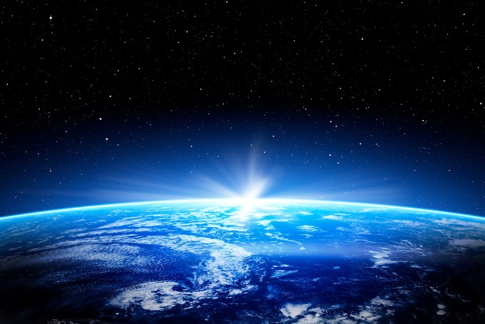
Growing in Holiness
2 PETER
A Verse of Hope:
“Nevertheless we, according to His promise, look for new heavens and a new earth in which righteousness dwell” (2 Peter 3:13)
Notes:
We do not have to fear the apocalypse, “the end of the world”. Nor do we have to leave our planet and move to the heavens, but heaven is going to come down to us and make all things new. Peter does not preach a pessimistic message of doom and gloom, but teaches a lesson of light appearing out of darkness, from doom to bloom.

Slide 7
2 Peter 1:12-15
Notes:
“For this reason I will not be negligent to remind you always of these things, though you know and are established in the present truth. Yes, I think it is right, as long as I am in this tent, to stir you up by reminding you, knowing that shortly I must put off my tent, just as our Lord Jesus Christ showed me. Moreover I will be careful to ensure that you always have a reminder of these things after my decease.”

Slide 8
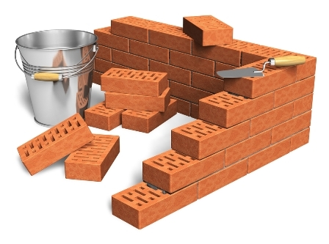
Growing in Holiness
2 PETER
The Prologue of the Letter – 1:3-11
The Basis of Holiness – 1:3-4
Notes:
Peter as a good shepherd is concerned about the moral character of his flock and the dangers that threaten them. He first reminds them of the basis of their holiness, the gracious provision of power and promises that God has provided for their growth in holiness (vs. 3-4) which are the foundational reason why we should follow through and add to our faith.

Slide 9
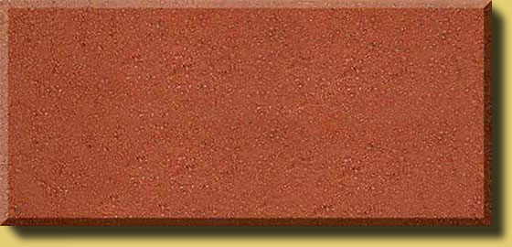
Growing in Holiness
2 PETER
The Prologue of the Letter – 1:3-11
The Basis of Holiness – 1:3-4
PARTAKE
POWER
PROMISE
KNOWLEDGE BASED FATIH
GOD’S GLORY AND VIRTUE
Notes:
Its because of God’s Person, His glory, His moral excellence, holiness and His love for us, that makes everything possible. It is the deepest foundation in whom we trust.
God’s is love, it is the reason that He loved the world and sent His Son as the provision for our salvation. Our faith is based in the knowledge of Christ’s person and provision and proclamation. It is by the means of our faith in Christ’s person and His provision that was proclaimed to us, that we received eternal life.
Our faith in Christ is also the means by which we are now made recipients of a spiritual equipping and empowering. It is knowledge based faith in Christ that is the means by which we can now access God’s power and promises.
It is God’s divine power that has sufficiently gifted us with all things related to life and godliness. Spirit born believers have all that they could possible need to live a godly life. Nothing else is needed.
God has also given us “exceedingly great and precious promises.” God has given us the promise of eternal life by believing in Christ. In Peter’s second letter the promises that he has most in mind are the promises that God has given us in order that we live godly in this life. And these promises, along with his power, are also the means by which we can become partakers of God’s nature.
The promises Peter has most in mind in this small epistle, are the future prophetic promises of the coming “parousia” of the Lord Jesus Christ. The “Parousia” includes the promise of His physical bodily coming “erchomai” to the earth in the future, in which at that time every eye on earth will see Him. This is the “apocalypse”--the revelation, which is the unveiling or uncovering of the Lord Jesus Christ which will bring an end to the age, the Mosaic age. The Mosaic age did not end in AD 70, but it is yet to be concluded.
Peter also has in mind the promise of a new heaven and earth in which only righteousness dwells, where there will no sin. At that time he will “wipe away every tear from their eyes; there shall be no more death, nor sorrow, nor crying. There shall be no more pain, for the former things have passed.” (Rev. 21:4) This is the completion of all things.
It is through these very great and valuable prophetic promises that we discover God’s purpose in given them, so that we can “participate”, “become partners” or “sharers” in God’s nature. God’s gift of divine power and promises are the means by which we can partake in His divine nature and work.
One of the great lessons of second Peter is that to maintain a holy life in a corrupt world like ours, we must be deeply fixed in the prophetic promises of God’s word. We must hold fast/stand in the “blessed hope” of the return of our Lord and Savior Jesus Christ. Failing to do so only leads to fear and to an absence of readiness. The absence of readiness then leads to a loss of future rewards, praise, honor, and glory.
Standing firm in the promise of His return is extremely valuable and important relevance to our growing in holiness. What we believe concerning His coming has great implications for how we live our life now and in the future.
Peter as a good shepherd is concerned about the moral character of his flock and the dangers that threaten them. He first reminds them of the basis of their holiness, which are the foundational reason why we should follow through and add to our faith. Next…
.

Slide 10
Growing in Holiness
2 PETER
The Prologue of the Letter – 1:3-11
The Basics of Holiness – 1:5-11
Notes:
But we need to know what that divine nature looks like, so Peter gives us the characteristics of holiness, telling us to diligent to add to our faith.

Slide 11
Growing in Holiness
2 PETER
LOVE
The Characteristics
of Holiness – 1:5-7
BRO. KINDNESS
GODLINESS
PERSEVERANCE
The Consequences
of Holiness – 1:8-9
SELF CONTROL
KNOWLEDGE
The Conclusiveness of Holiness – 1:10-11
VIRTUE
FAITH
Notes:
The characteristics of holiness…
In verses 8-9 he states the case positively, that if these qualities are diligently pursued it will produce active, fruitful Christians and he states the case negatively that those who fail to diligently pursue these attributes leads to a blind and shortsighted life which God’s past grace is seemly forgotten. Producing an active, fruitful life now is the first reason that moral development is to motivate diligence in spiritual growth.
The second reason (10-11) these traits should motivate us to increased diligence are the results of a broader scope. For these results include a verification of our calling and election to service and a magnificent entrance into the coming kingdom of God. These words “calling and election/choosing: brings to mind the famous statement of the Lord that ”many are called, but few are chosen”

Slide 12
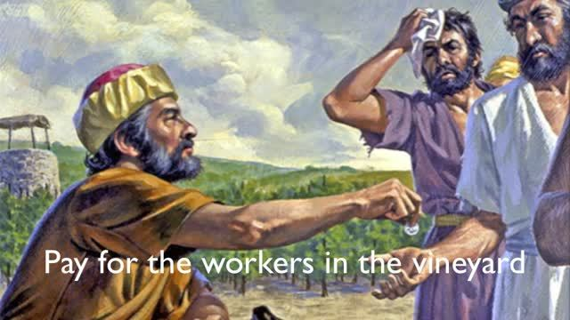
Growing in Holiness
2 PETER
”For many are called, but few are chosen." (Matthew 20:16, 22:14)
The Parable of the Workers of the Vineyard (Matthew 20:1-16)
The Parable of the Wedding Supper (Matthew 22:1-14)
Notes:
These words are found twice in the Gospels, both in Matthew 20:16; 22:14, but are words Peter must have heard many, many times. In any case, these words by Jesus occurs in eschatological contexts, that is the choosing will occur in the future, in the latter days. These words are spoke by Jesus concluding two parables, “The Parable of the Workers of the Vineyard” (20:1-16) which follows the vineyard owner’s decisive pronouncement about the wages of the workers, and “The Parable of the Wedding Supper” (22:1-14) which follows the host’s decisive command to expel the improperly dressed man. So, we see, it has a positive and a negative application.
The parable of the Vineyard workers refers to Christian service up to the Lord’s return for His Church, while the man in the parable of the Wedding Supper concerns those who have not prepared themselves for the host’s review. It can represent believes who are unprepared for the Judgment Seat of Christ, which is the believers evaluation of his service to the Lord by the Lord.
From both parables it is plain to see that the “choice” follows the “call”. The vineyard workers are called or invited to work/serve the Lord, but the choice about their wages is made by the vineyard owner in the evening, that is at the end of the day. Some are “chosen” to receive pay equal to those who worked longer. [God does not pay slave wages, to His workers]. In the Wedding Feast many are “invited” and many turn down the invitation. But even one who came appeared poorly dressed was not “chosen” to participate, although he had been “called”.
Many are called to salvation, many if not most turn down the invitation. Many are called to service for Christ, to take up their cross and follow Him and become His disciples, many are called to add to their faith, many if not most turn down the invitation. Those who heed the call are chosen for further service—The Lord will say to the chosen, 'Well done, good and faithful servant; you have been faithful over a few things, I will make you ruler over many things. Enter into the joy of your master.‘ (Matt. 25:23)

Slide 13
Growing in Holiness
2 PETER
LOVE
The Characteristics
of Holiness – 1:5-7
BRO. KINDNESS
GODLINESS
PERSEVERANCE
The Consequences
of Holiness – 1:8-9
SELF CONTROL
KNOWLEDGE
The Conclusiveness of Holiness – 1:10-11
VIRTUE
FAITH
Notes:
Peter clearly encourages the building of Christian character (5-7) which in turn, leads to Christian activity and fruitfulness (8) This active and fruitful life lead to pay as it did for the vineyard workers. The vineyard workers were given their wages/pay “misthos” which is also a common word in the NT for “reward”. The lifestyle that Peter commands will prepare us to be properly ‘clothed’, when we first meet the Lord in the air, unlike the poorly dressed man who appeared at the wedding feast.

Slide 14
Growing in Holiness
2 PETER
LOVE
Basis
BRO. KINDNESS
Power and Promises
GODLINESS
PERSEVERANCE
Personal Results -
Positive and Negative
SELF CONTROL
KNOWLEDGE
Proof and Praise
VIRTUE
FAITH
Notes:
“Peter has thus far argued for the moral development presented (5-7) on the basis of (1) God’s gracious powerful and promised provisions for Christian living (3-4), and on the basis of personal results, both positive and negative, that the presence or the absence of these traits produce (8-9).” [Hodges, p. 27]
Then Peter argued that these traits of moral development (5-7) should motivate us to increased diligence on the basis of a broader scope. For these results (10-11) include Proof of our calling and choosing for service, and plentiful Praise before all those under heaven.

Slide 15
Growing in Holiness
2 PETER
The Purpose of the Letter – 1:12-15
To Establish Them in the Present Truth
Notes:
After the introduction, know as the prologue in verses 3-11, the Apostle Peter discloses his purpose in writing this letter in verses 12-15. His purpose is that his readers stand firm and to establish them in the present truth. His letter is in essence is a sermon put down on paper, with an preface attached to the front end.
In the prologue Peter proclaims the great spiritual provisions every believer is given when they first believe in Christ, and are born anew. These provisions are only given to believers. Among these provisions is the power or strength to live a holy life for Christ, adding to our faith the characteristics of holiness. Peter had also specified the “exceedingly great and precious promises” in particularly, as the means by which we may escape “the corruption that is in this world” (1:4)
The promises he has a in mind are “eschatological” promises--the promise of Christ’s coming, His physical and bodily return to the earth and all related events. These promises have and will, come under attack from “scoffers” (3:3-4) who deny Christ physical return, some today even saying that He has returned already. The remainder of the epistle is basically a defense, “apologia”, of the godly lifestyle to which the great promises concerning the end of all things inspires us (3:11-13). The “scoffers” in turn are condemned for their unbelief and skepticism. The “scoffers” are also condemned for their immoral lifestyle, which is a direct result of their denial of Christ’s coming in judgment.
In this brief section of the letter (1:12-15) Peter reinforces the immediate truth his readers already possess and encourages them to stand firm and not be moved from their present position, but the danger always exists that they could fall into error.

Slide 16
Growing in Holiness
2 PETER
The Purpose of the Letter – 1:12-15
“For this reason I will not be negligent to remind you always of these things, though you know and are established in the present truth.” (1:12)
To Establish Them in the Present Truth
Notes:
When Peter says “for this reason” he is referring back to the very reasons they should diligently pursue the lifestyle of holiness by pointing out that it produces fruitfulness (1:8) and stability (1:10) and leads to a rich entrance and life into the everlasting kingdom of God.

Slide 17
Growing in Holiness
2 PETER
The Purpose of the Letter – 1:12-15
“For this reason I will not be negligent to remind you always of these things, though you know and are established in the present truth.” (1:12)
To Establish Them in the Present Truth
Notes:
When Peter states, “I will not be negligent to remind you always of these things” he expects his readers to understand that this is the very thing he is doing in this sermon. He does not want them to forget these essential truths. What he is doing now, he pledges to always do so, not only while he is still alive, but will diligently make sure they will have a permeant reminder of these truths, even after he is dead and gone. Peter promises that he will not be found negligent or careless.

Slide 18
Growing in Holiness
2 PETER
The Purpose of the Letter – 1:12-15
“For this reason I will not be negligent to remind you always of these things, though you know and are established in the present truth.” (1:12)
To Establish Them in the Present Truth
Notes:
These truths are definitely not something new to Peter’s readers. He must had already taught them these matters when he was with them in person. Instead, these readers know them already and this letter is simply a reminder of what they already know and have been taught.
And not only do they know these things, but furthermore they are well established in the present truth. He calls them “steadfast” in 3:17. “Peter does not regard his readership as waverers about to give up the truth, but basically stable. Yet—like all of us—they can benefit from the Apostle’s reminder.”
“the present truth” is “the truth that you have”. This is not some distant truth from the past or in the distant future, but a near truth that has been given to them recently. This could be a phrase similar to the parallel letter of Jude which makes reference to “the faith which was once for all delivered to the saints” (Jude 3). Peter stands at the end of the apostolic age (AD 68). Peter mentions of a number of Paul’s writings, “in all his epistles” (3:14-15) which may have been already gathered together into a collection by Luke. “Peter is implying that the readers do not need any new teaching (such as the false teachers might bring 2:1), but that they already have the truth and are grounded in it. All they need to do is to hold on!” [Hodges, p. 37) -- To stand firm in the truth!
We all know of the history of the Church as a whole shows how careless the Church has been about clinging to divine revelation. The Reformation truths of solofide, salvation by faith alone, and soloscriptura, we know this by Scripture alone has been lost by many evangelicals. Many are calling for another Reformation to occur again today. Yes, we must drill the truth into those we teach by constant reminders.

Slide 19
Growing in Holiness
2 PETER
The Purpose of the Letter – 1:12-15
“Yes, I think it is right, as long as I am in this tent, to stir you up by reminding you, knowing that shortly I must put off my tent, just as our Lord Jesus Christ showed me.” (1:13-14)
To Establish Them in the Present Truth
Notes:
And Peter says he intends to go on reminding them, “as long as I am in this tent”, that is, for the rest of his present earthly life. Of course a “tent”, a reference to his present earthly body, which is only a temporary structure.

Slide 20
Growing in Holiness
2 PETER
The Purpose of the Letter – 1:12-15
To Establish Them in the Present Truth
Notes:
When I go camping we set up on tents on Friday, only to take the down again on Sunday. They are only temporary structures for the weekend.

Slide 21
Growing in Holiness
2 PETER
The Purpose of the Letter – 1:12-15
“For we know that if our earthly house, this tent, is destroyed, we have a building from God, a house not made with hands, eternal in the heavens.” (2 Corinthians 5:1)
To Establish Them in the Present Truth
Notes:
Paul calls “this tent, our earthly house,” but not to worry if it is destroyed for God has prepared a eternal house for our spirit to dwell in the heavens, “a house not made with hands, a building from God” Himself. The term is used of “the transience of the mortal human body, which is only a temporary abode for our immortal soul. At the resurrection, however, the body is transformed and made immortal.” [Hodges, p. 38]

Slide 22
Growing in Holiness
2 PETER
The Purpose of the Letter – 1:12-15
“Yes, I think it is right, as long as I am in this tent, to stir you up by reminding you, knowing that shortly I must put off my tent, just as our Lord Jesus Christ showed me.” (1:13-14)
To Establish Them in the Present Truth
Notes:
Peter had previously mention in his first letter that we are here on the earth as “sojourners and pilgrims” (1:1; 2:11), here “only for a little while” (1:16). His remaining days of “tenting” in this world, would be used to drum into his readers the truths he had previously taught them -- “repetition is the mother of studies”.

Slide 23
Growing in Holiness
2 PETER
The Purpose of the Letter – 1:12-15
“Yes, I think it is right, as long as I am in this tent, to stir you up by reminding you, knowing that shortly I must put off my tent, just as our Lord Jesus Christ showed me.” (1:13-14)
To Establish Them in the Present Truth
Notes:
Peter is motivated to this goal of reminding them of these things by the realization that his present life in his earthly tent would soon end. He is aware “that shortly I must put off my tent”. “Peter is acutely conscious that his life will not last much longer.” [Ibid]
The term “shortly” refers to Peter realization that the prediction of the Lord was about to be fulfilled because the prediction would occur “when you are old”, and at the writing of this letter, Peter is now old. Most likely in his 60’s. He had good reason to conclude that his martyr’s death was not too far away. If in fact he was in Rome, the situation under Nero’s persecution may have reinforced this impression.

Slide 24
Growing in Holiness
2 PETER
The Purpose of the Letter – 1:12-15
“Yes, I think it is right, as long as I am in this tent, to stir you up by reminding you, knowing that shortly I must put off my tent, just as our Lord Jesus Christ showed me.” (1:13-14)
To Establish Them in the Present Truth
Notes:
No doubt this is a reference to what Jesus had told him while they were in Galilee prior to Christ ascension into heaven. This is recorded in John 21:18-19.

Slide 25
Growing in Holiness
2 PETER
“Jesus said to him, ‘Feed My sheep. Most assuredly, I say to you, when you were younger, you girded yourself and walked where you wished; but when you are old, you will stretch out your hands, and another will gird you and carry you where you do not wish.’ This He spoke, signifying by what death he would glorify God. And when He had spoken this, He said to him, ‘Follow Me’.“ (John 21:17-19)

Slide 26
Growing in Holiness
2 PETER
The Purpose of the Letter – 1:12-15
“Yes, I think it is right, as long as I am in this tent, to stir you up by reminding you, knowing that shortly I must put off my tent, just as our Lord Jesus Christ showed me.” (1:13-14)
To Establish Them in the Present Truth
Notes:
Peter would shortly put off his tent, his body--he going to die, “that is” or “in the way that” Jesus had predicted that he would die. He would die as a martyred. The stretching out of the hands is a prediction that Peter was going to be crucified. And tradition says that Peter was crucified, upside down at his request, under Nero’s persecution in 67 or 68 AD. Peter swore that he was ready to go with Jesus to prison and to death (Luke 22:34). And so he would.

Slide 27
Growing in Holiness
2 PETER
The Purpose of the Letter – 1:12-15
“Moreover I will be careful to ensure that you always have a reminder of these things after my decease.” (1:15)
To Establish Them in the Present Truth
Notes:
Lastly or “Moreover”, in view of Peter’s impending departure, he is concerned not only with the here and now, but also with leaving them with a permanent reminder, to leave a reminder behind. He literally wants to leave them something with which they can hold in their hands with which they could remember the things he had taught them.
“And what might this something be? A plausible suggestion has been made that the reference is to the Gospel of Mark [which was most likely already in the works]. According to an ancient tradition, Mark’s Gospel reflects the preaching of Peter, stories of Jesus that Mark had heard Peter tell many times. The stories of Jesus that Peter had told to his readers through the region and cities that he evangelized. “these things” were not something new to them. They had heard them orally. Now, since some in Peter’s day apparently thought the miraculous stories of Jesus’ life on earth consisted of “cunningly devised fables/myths”, a written historical record of that life would be a valuable reminder of what had really happened. As a document based on Peter’s own eyewitness testimony, Mark’s record would have a strong claim to credibility, as well as being an ever-ready “reminder” of the truths Peter had personally taught.” [Hodges, p. 39]
We can someday thank Peter that he has left us a permanent reminder of the stories of Jesus as the powerful Son of God and the Suffering Servant in the Gospel of Peter, as we might call it.

Slide 28
Growing in Holiness
2 PETER
Chronological Order of New Testament Books
James – 45-49
Ephesian - 61
1 Peter – 63-64
Galatians - 49
Colossians - 61
2 Peter - 66
1 & 2 Thess. – 51-52
Philippians - 63
Hebrews – 68
Luke/Acts - 68
1 & 2 Corn. – 55-57
Philemon - 63
1 Timothy - 63
Mark - 69
Romans – 57-58
Titus - 65
Jude – 80’s
Matthew – 50’s
2 Timothy - 67
John’s – 85-90’s
Notes:
THE CHURCH HISTORY OF EUSEBIUS\Book Five\Chapter 8 - The Statements of Irenaeus in Regard to the Divine Scriptures - THE CHURCH HISTORY OF EUSEBIUS\Book Five\Chapter 8 - The Statements of Irenaeus in Regard to the Divine Scriptures section 6.
The Statements of Irenaeus in Regard to the Divine Scriptures -- Since, in the beginning of this work, we promised to give, when needful, the words of the ancient presbyters and writers of the Church, in which they have declared those traditions which came down to them concerning the canonical books, and since Irenaeus was one of them, we will now give his words and, first, what he says of the sacred Gospels:
"Matthew published his Gospel among the Hebrews in their own language, while Peter and Paul were preaching and founding the church in Rome. After their departure Mark, the disciple and interpreter of Peter, also transmitted to us in writing those things which Peter had preached; and Luke, the attendant of Paul, recorded in a book the Gospel which Paul had declared. Afterwards John, the disciple of the Lord, who also reclined on his bosom, published his Gospel, while staying at Ephesus in Asia."
He states these things in the third book of his above-mentioned work. In the fifth book he speaks as follows concerning the Apocalypse of John, and the number of the name of Antichrist:
"As these things are so, and this number is found in all the approved and ancient copies, and those who saw John face to face confirm it, and reason teaches us that the number of the name of the beast, according to the mode of calculation among the Greeks, appears in its letters. ..."
And farther on he says concerning the same: "We are not bold enough to speak confidently of the name of Antichrist. For if it were necessary that his name should be declared clearly at the present time, it would have been announced by him who saw the revelation. For it was seen, not long ago, but almost in our generation, toward the end of the reign of Domitian.
Nicene and Post-Nicene Fathers, Series 2, Volume 1, PC Study Bible formatted electronic database Copyright © 2003, 2006 by Biblesoft, Inc. All rights reserved.

Slide 29
Growing in Holiness
2 PETER
Conclusion
Notes:
Peter’s purpose in writing this epistle is to reinforce to his reader’s minds familiar truths. I stand here today also reminding you of these truths which hopefully you know and will to stand firm in them. These truths were already were being challenged in Peter’s day, they continue to be challenged throughout church history up till now.

Slide 30
Growing in Holiness
2 PETER

Slide 31
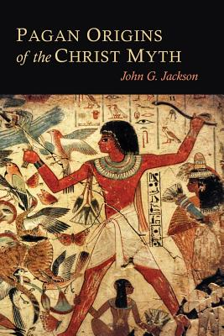
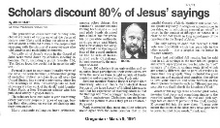
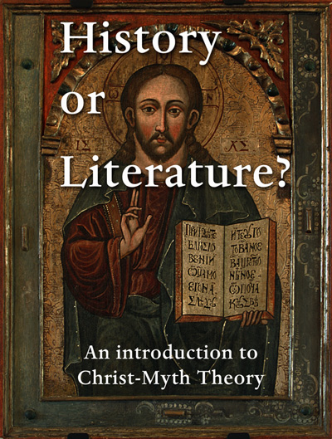
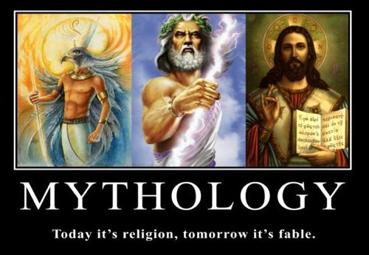
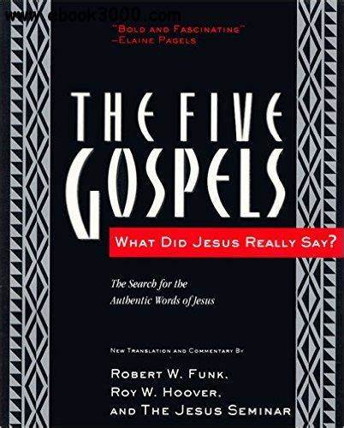
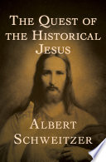
Growing in Holiness
2 PETER
Notes:
The question remains will we stand firm with the onslaught of critics who continue to say that the stories of Jesus are cunningly devised myths. Will you stand up for Jesus or will you fall for the scoffers.

